Slide 1
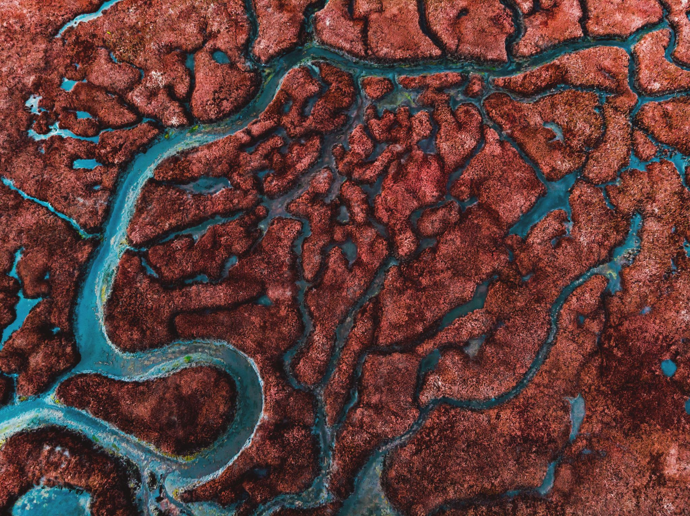
Microbes in Arctic Lakes
Sarah Gering
What taxa are involved in differences in community composition and on the distribution of bacterial cell membrane lipid biomarkers in arctic lake soils and sediments?
Notes:
Acknowledgements: Collaborative Project with Julio Sepúlveda and Jon Raberg from INSTAAR

Slide 2
Motivation and Background
Lipid biomarkers can be used to determine paleolithic conditions given environmental changes, such as temperature and pH.
We also know biolipid structures associated with certain taxa from microbes grown in culture in labs, but most taxa cannot be cultured.
What we don’t fully know is if there are specific taxa that can be directly correlated with the abundance of certain classes of biolipids in these arctic soils and sediments.

Slide 3
Approach
I will answer this question by using taxonomic tables developed and processed in our lab from samples collected from arctic lakes in Iceland and Canada by our collaborators at INSTAAR.
My role in this collaborative project is to investigate the microbial community associated with arctic lake samples

Slide 4
About the Data
Sample Types
Sediment Core – tube of mud from bottom of lake
Surface Sediment – top layer of sediment in modern lakes
Riverbank Sediment
Shore Sediment
Soils
Sediments from ancient lakes
Sample Metadata
Site
Depth
Temperature
pH
Latitude and Longitude
Elevation
Mean Annual Air Temperature
BrGDGTs (biolipids)

Slide 5
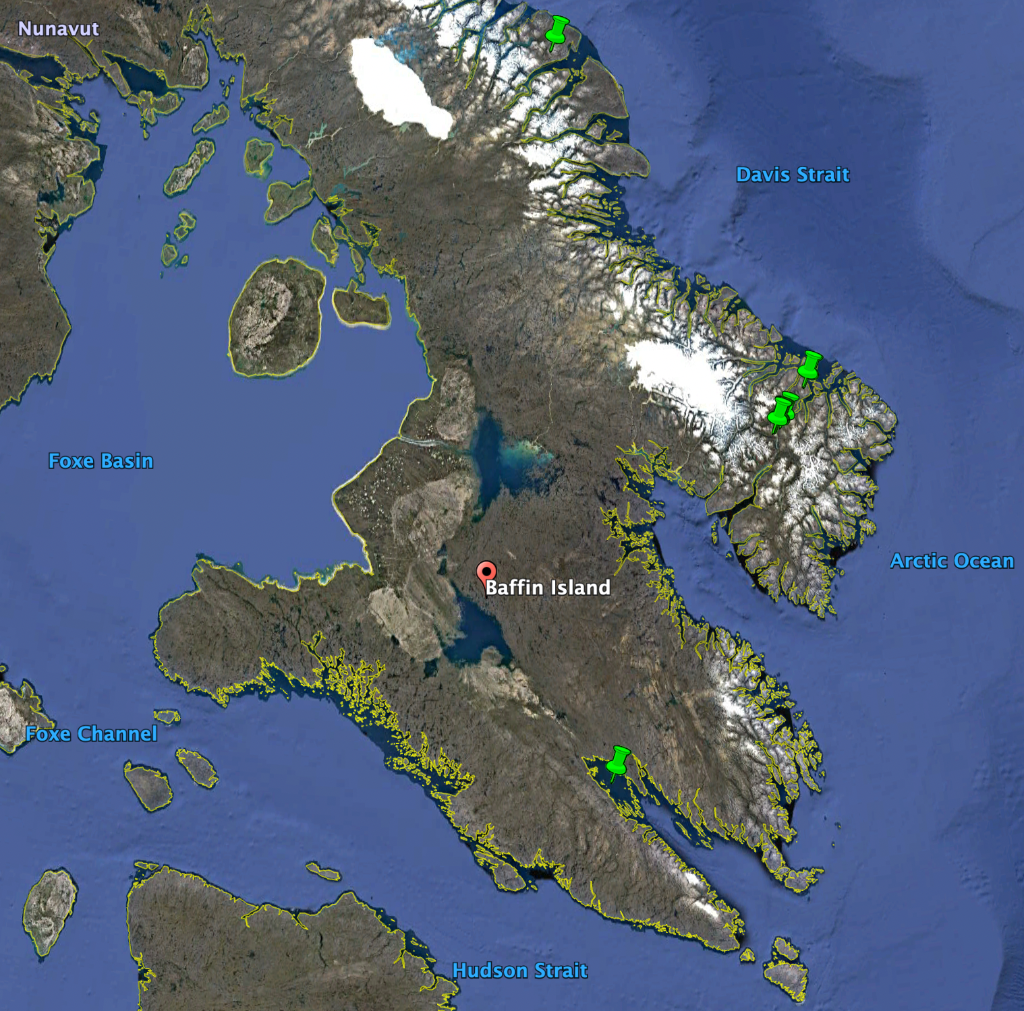
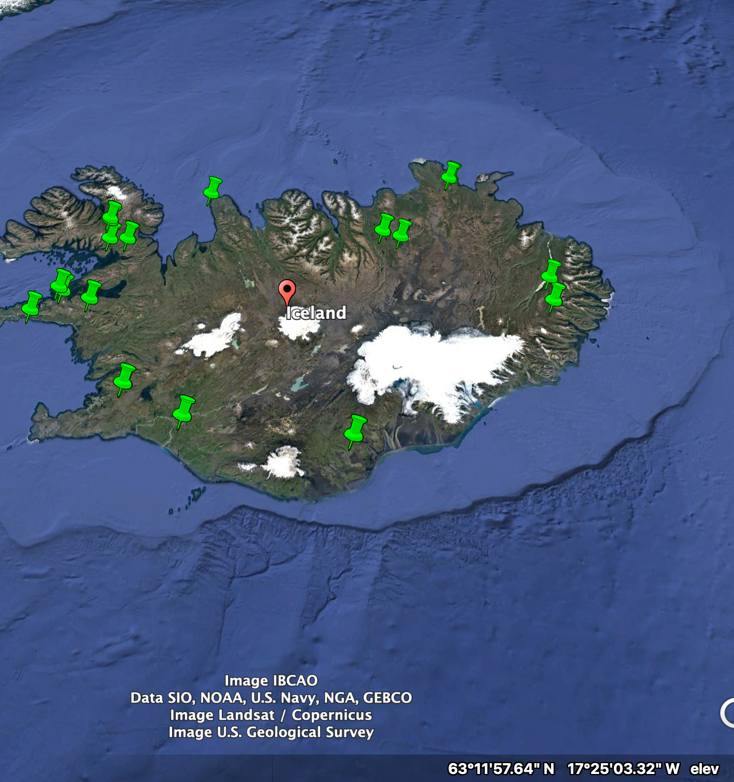
Maps of Samples
Soil and sediment samples
Iceland
Modern soils and sediment n = 41
Ancient sediments n = 49
Baffin Island, Canadian Arctic
Modern n = 35

Slide 6
Anticipated Details
The analysis will involve an in-depth view of relative abundances of taxa, alpha and beta diversity, and environmental variables associated with community composition.
Ultimately, the goal will be to develop correlations between specific taxa and classes of biolipids related to environmental variables such as temperature and pH.

Slide 7
Anticipated Results
I will know my project is a success if I am able to correlate relative abundances of specific taxa at the phyla level to fractional abundances of biolipid (brGDGT) classes in arctic soil and lake sediments.

